Slide 1
Capstone Project MS, Applied Data Analytics (Class of 2018) Joshua troup project title: fast food marketing campaigns Adviser: Dr. annadatha Department of Computer Information Science College of Business Administration and Information Science
Notes:
Good morning/afternoon

Slide 2
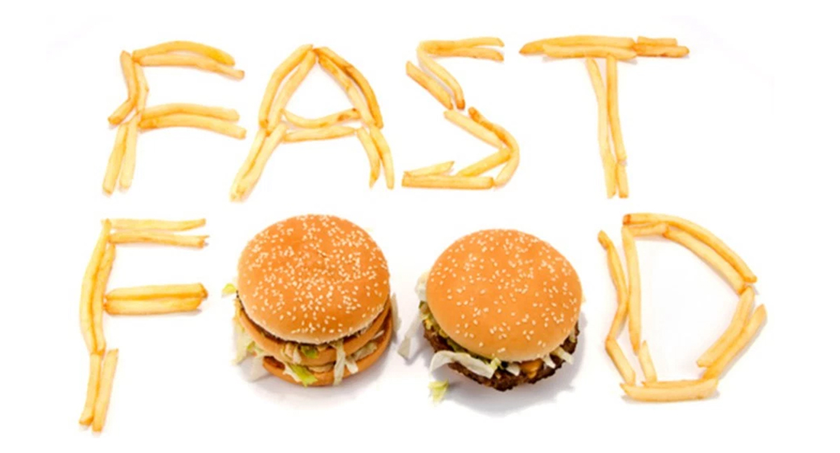
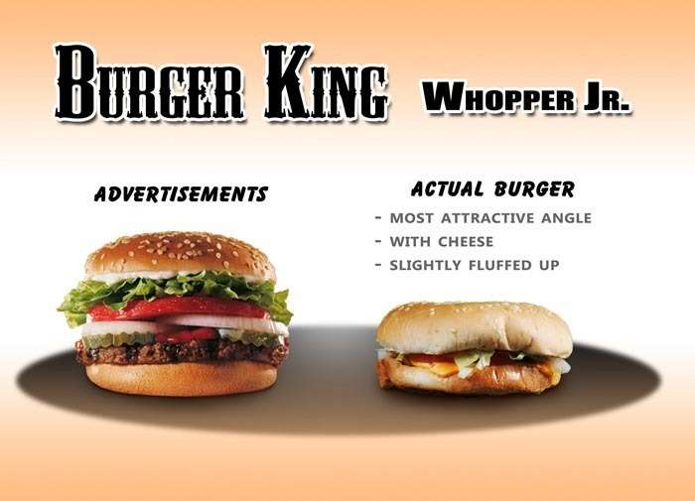

Motivation/Problem
Notes:
Raw data once was considered invaluable as it is unstructured with little to no insight to key decision makers. Businesses require the raw data to be transformed in a manner that an analysis can be performed to assist on that businesses success rate. The vast amounts of unstructured data can now be transformed into a cluster of a specific customer type, customer satisfaction, customer retention, and overall efficiency of a particular department within a business. Analyzing marketing conditions to pin point what is effective is what is not can save companies millions if not billions of dollars a year.

Slide 3
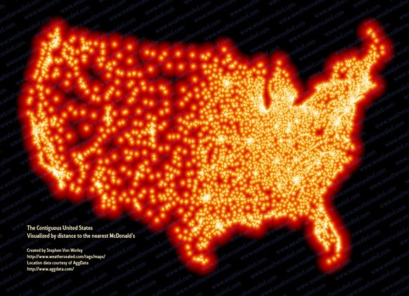
Motivation/Problem
Notes:
Introduction of new products and services can now be analyzed in more than one way to determine best location or promotion concept delivers the best result. “According to a New York Times article, there are about three new McDonald’s Opening every day. The main goal is not to have any person more than four minutes away from a branch.” (Kannammal, 2016) According to (Kannammal, 2016) “Fast food began after the Second World War. It has come a long way and has achieved unmatchable success and popularity. The success of the fast food chains rest on its marketing strategy and selling Point.” Fast food franchises use many advertising techniques to reach customers of all ages by using brand awareness, budgets, and target market with the assistance of online, radio, television, and print strategies.
*Shown above is visual representation of all the McDonald locations across the USA. There seems to be more McDonald's on the eastern part of the country than central or western.

Slide 4
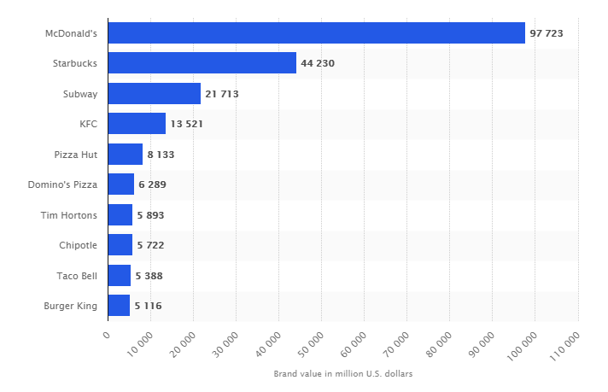
Motivation/Problem
Notes:
Brand value of the 10 most valuable fast food brands worldwide in 2017 (in million U.S. dollars)

Slide 5


Analytical Tools
Notes:
IBM Watson Analytics is a powerful cloud based program developed to analyze and visualize large data sets using a series of technology advancements including artificial intelligence, statistics, computer science, and mathematics. IBM started Watson as a follow-on project to DeepBlue which was the computer program that defeated world chess champion Gary Kasparov.

Slide 6
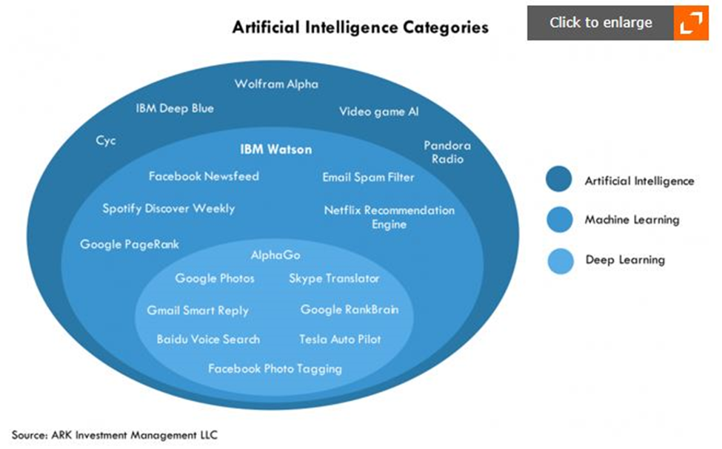
Analytical Tools
Notes:
Fig 1 displays the three artificial intelligence categories with real world examples inside the blue circles. “As a quick refresher, artificial intelligence can be divided into three categories, as shown above. The first category is AI itself, defined broadly and covering all possible approaches to simulating intelligence. A subset of artificial intelligence is machine learning (ML), which uses data and experience automatically to tune algorithms. Finally, a subset of ML is deep learning (NYSE:DL). Deep learning uses brain inspired algorithms – neural networks – to simulate the learning process.” (Seeking Alpha, 2017)

Slide 7
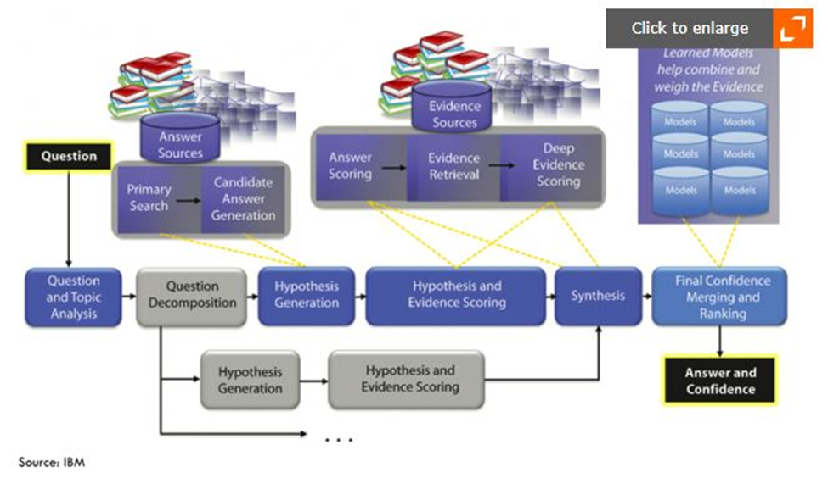
Analytical Tools
Notes:
The processing engine attempts to dissect the questions into words in Fig 2, seeking correlations between words and isolating the subject of the question. Search analysis is performed by the AI engine sifting through unstructured data in a manner similar to Google search engine. Watson finally computes a confidence level per answer with the strongest level selected for the user. “To summarize, IBM Watson is a system that performs open domain question-answering. It uses multiple AI techniques such as rule based language parsing, knowledge bases, search, and statistical machine learning. Its strength is that it can interpret complex queries expressed in natural language, consult many data sources, generate many possible answers, score them based on evidence, and select answers with good accuracy.” (Seeking Alpha, 2017)

Slide 8
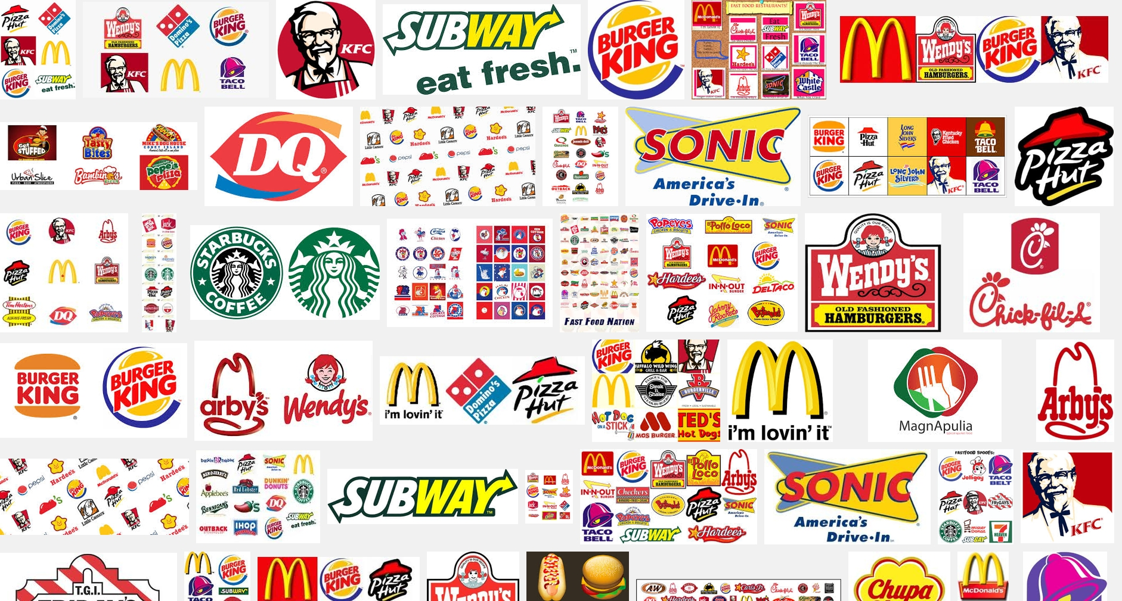
Data Set
Notes:
Marketing campaigns are a must for every profitable business interested increasing revenue whether it is a brick and mortar establishment or online based company. A large portion of a company’s revenue is constantly reinvested back into marketing and R&D. Data analytics can assist in cost savings for a marketing team with hard facts from the data on which campaigns work and which ones do not. I have chosen to analyze a fast food marketing data set attempting to determine the best marketing campaign for a newly introduced product in a variety of locations.
DATASET: WA_Fn-UseC_-Marketing-Campaign-Eff-UseC_-FastF.xlsx

Slide 9
Data Set Variables
MarketID | Unique identifier for market (1 – 10).
MarketSize | Size of market area by sales (Small, Medium, Large).
LocationID | Unique identifier for store location.
AgeOfStore | Age of store in years (1 – 28).
Promotion | One of three promotions that was tested (1, 2, 3).
Week | One of four weeks when the promotions were run (1 – 4).
SalesInThousands | Sales amount for a specific LocationID, Promotion and week.

Slide 10
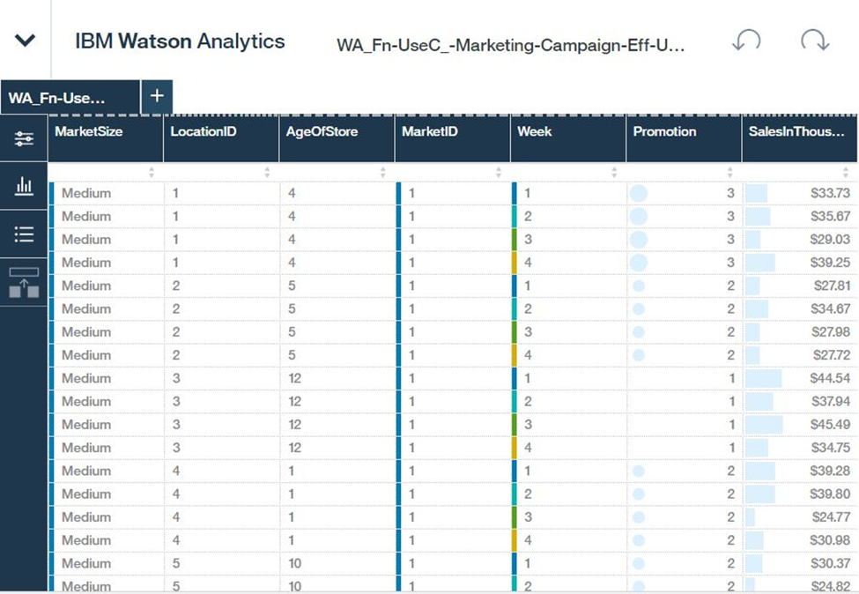
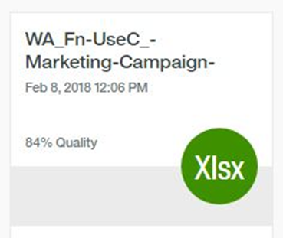
Data Preprocessing
Notes:
The Fast Food Marketing dataset does not contain any missing values therefore no modifying to values will be conducted. Fig 4 shows the data having an 84% quality rate. Data partitioning data into training, testing, and validation sizes is not supported by IBM Watson Analytics therefore the dataset including variables will be closely inspected before analysis process. The dataset does not contain outliers or noise as the data is considered clean. Transformation of variables is not necessary in the dataset.

Slide 11
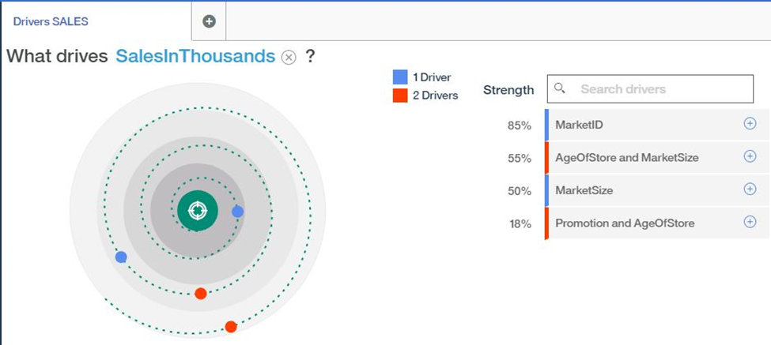
Analysis
Fig 5
Notes:
Fig 5 displays the top drivers of SalesInThousands. MarketID has the strongest predictor of 85% in correlation with driver 2 AgeOfStore and MarketSize with a predictive strength of 55%. MarketSize, Promotion, and AgeOfStore are the second set of predictive drivers.

Slide 12
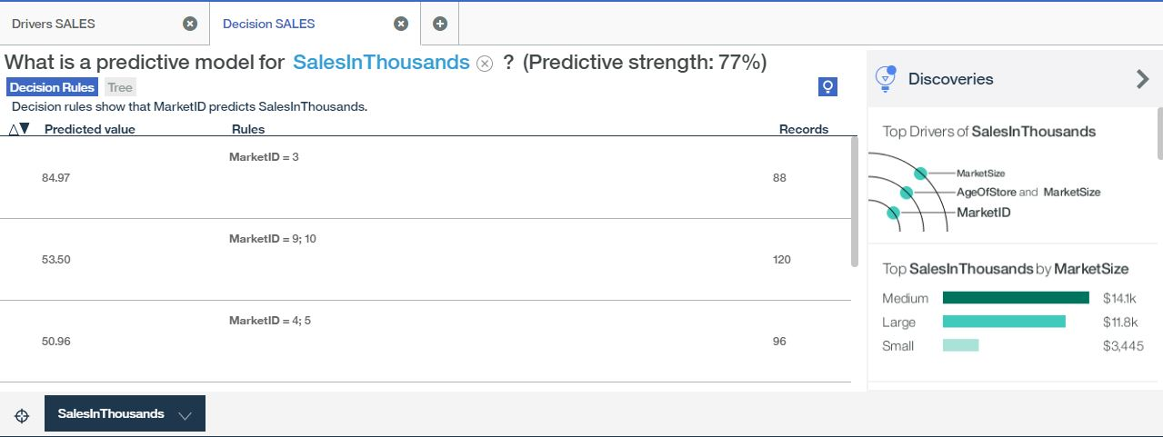
Analysis
Fig 5.1
Notes:
(Next slide with explanation)

Slide 13
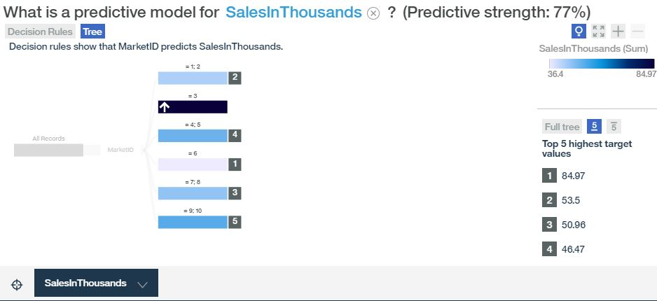
Analysis
Fig 5.2
Notes:
Fig 5.1 and 5.2 display the decision tree and rules based on SalesInThousands. MarketID three shows to have the greatest impact on SalesInThousands with a target value of 84.97%.

Slide 14
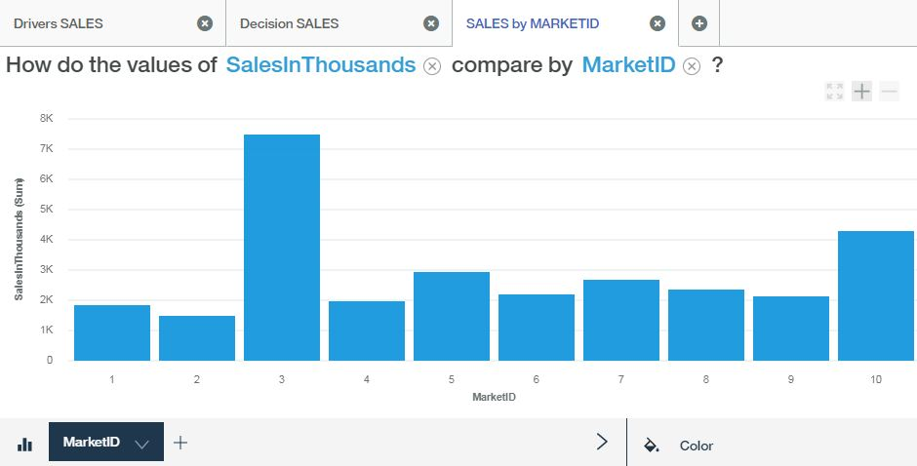
Analysis
Fig 5.3
Notes:
The bar chart is Fig 5.3 visualizes the difference in revenue market three produced a value of $7,477.51 compared to the other nine markets.

Slide 15
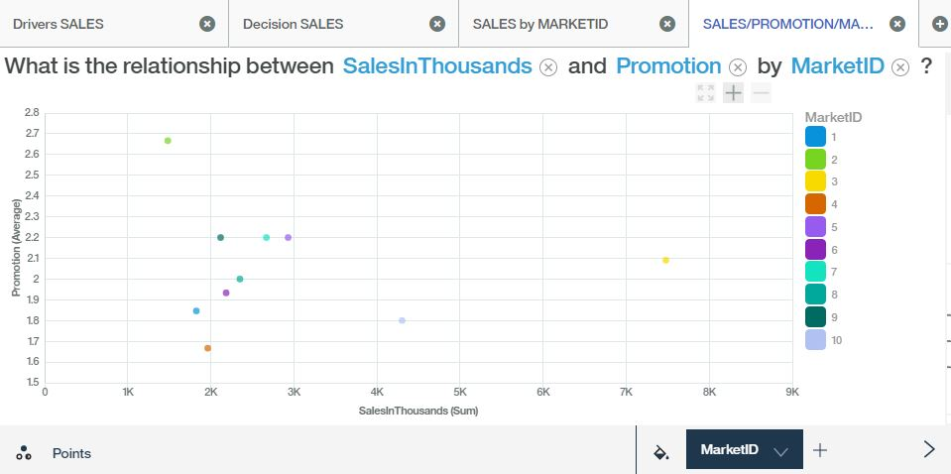
Analysis
Fig 5.4
Notes:
The relationship between SalesInThousands, Promotion, and MarketID is shown above in Fig 5.4. Market three with a sales value of $7,477.45 used an average promotion of 2.09 based out of the one, two, or three promotion types used.

Slide 16
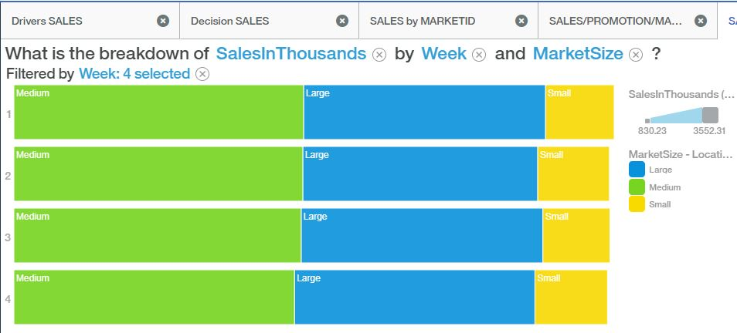
Analysis
Fig 5.5
Notes:
SalesInThousands breakdown by Week and MarketSize displays a significant pattern in Fig 5.5. Medium size market is shown to be the largest revenue producing market consistently for four weeks compared to the other two market sizes.

Slide 17
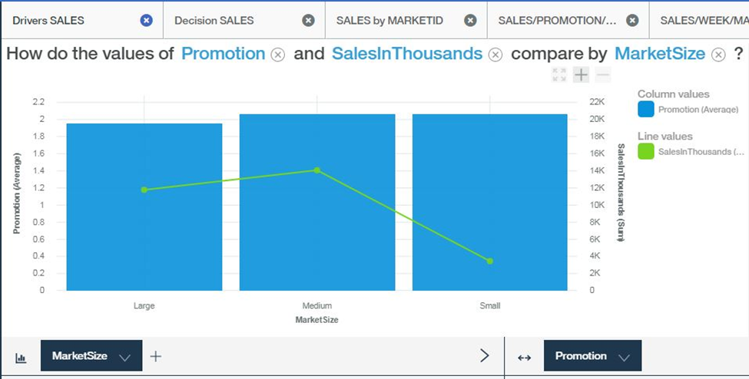
Analysis
Fig 5.6
Notes:
Fig 5.6 displays the correlation between Promotion, SalesInThousands, and MarketSize. The bar chart easily showcases the most common type of promotion is based on promotion type two.

Slide 18
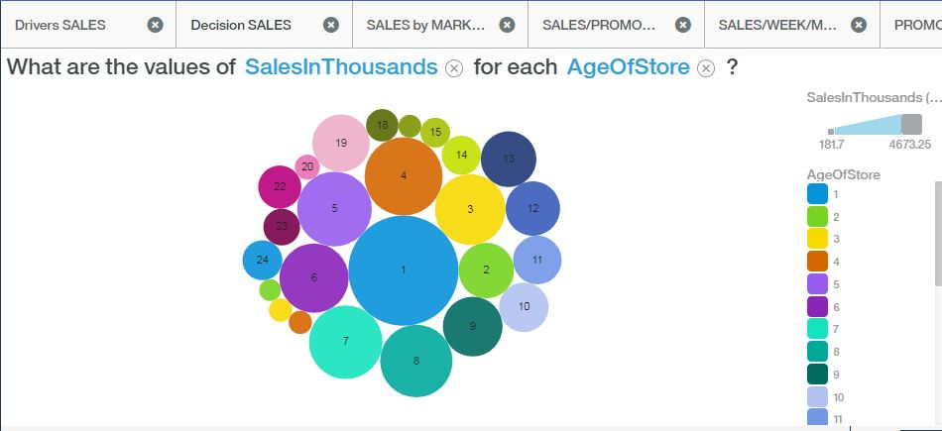
Analysis
Fig 5.7
Notes:
The correlation between SalesInThousands and AgeOfStore is fairly significant shown in Fig 5.7. The stores with an age of one year to nine years prove to produce more sales with the exception of the second year store. The older the store, the less sales are made.

Slide 19
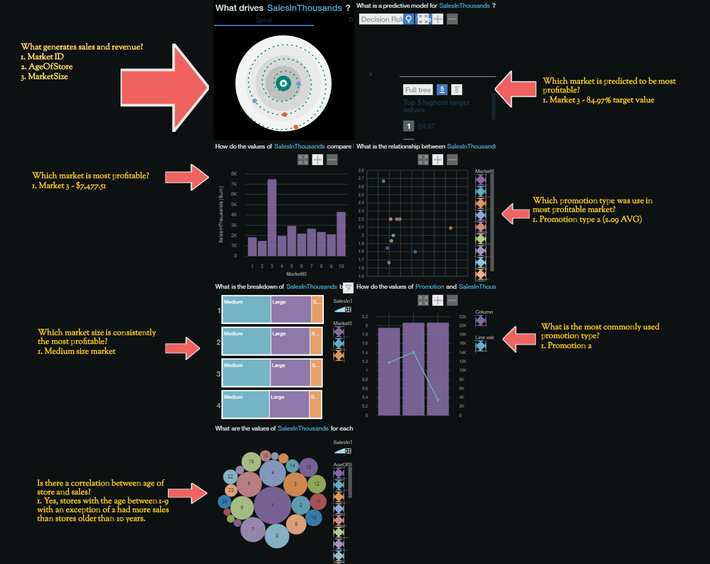
Findings/Insights
Notes:
The dashboard display view of the analysis performed with insights for each model.

Slide 20
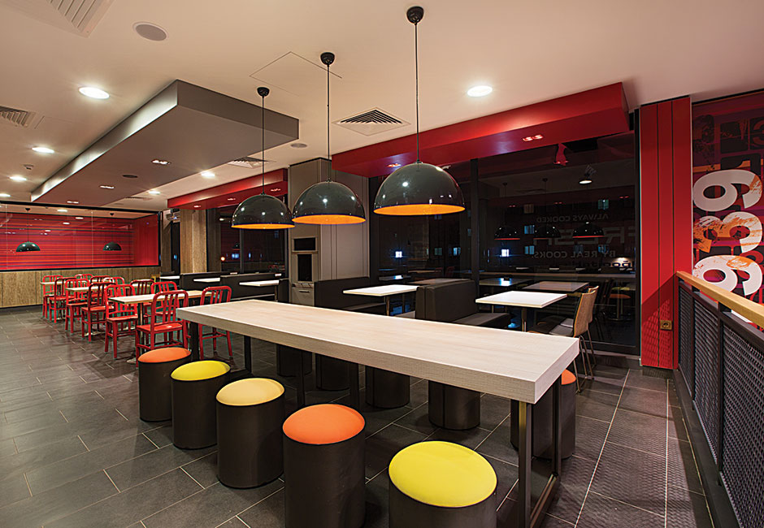

Conclusions
Notes:
After discovering many valuable insights within the fast food marketing data set, I have determined promotion type two to be the most widely used campaign delivering excellent results in medium size markets. I found age of store to be ironic in my findings as it does have an impact on sales and marketing. The decision to build more brick and mortar stores in a medium size market similar to marketID three location using a promotion type two would be beneficial to the company. According to (Kannammal, 2016) “Fast food contains several ingredients that are very harmful to health of the consumers. Therefore, as a long term business strategy, fast food companies have to utilize their research and development to make their recipes healthier and filled with nutritional values. This would ensure not only the growth of fast food businesses but also safeguard its consumers from health hazards and lifestyle diseases.”

Slide 21
References
http://www.anthonygaenzle.com/facebook-fast-food-ethics-marketing-children/
https://www.trendhunter.com/slideshow/food-marketing
https://pushcrew.com/blog/best-kept-secrets-fast-food-marketing/
https://skylertanner.com/2010/04/30/supersize-me-revisted-under-lab-conditions/
https://registrarjournal.com/2018/01/04/battle-brewing-as-fast-food-giants-launch-low-priced-menu-items.html
https://indiefilmhustle.com/garry-kasparov-masterclass-chess-grandmaster/
http://www.techweez.com/2017/07/13/ibm-cognitive-services/
https://pazherbs.com/all-fast-food-restaurants/
https://www.designretailonline.com/projects/trends/trends-in-fast-food-retail-design/

